Slide 1

R.O.K Parliamentary Diplomacy in 2019
Dohee Kim
Foreign Affairs and National Security Team National Assembly Research Service
2019.11.7.

Slide 2
Table of Contents
1. Why Conduct Parliamentary Diplomacy?
2. An Overview of Parliamentary Diplomacy
3. The current Status of Parliamentary Diplomacy
4. Suggestions for Further Development

Slide 3
I. Why Conduct Parliamentary Diplomacy?

Slide 4


R.O.K. Speaker Moon Hee-sang –
U.S. House Speaker Nancy Pelosi, Feb. 12, 2019
1

Slide 5
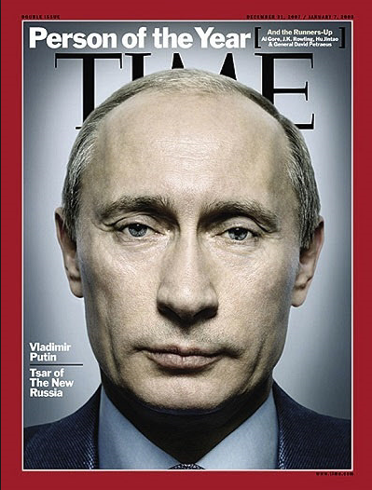
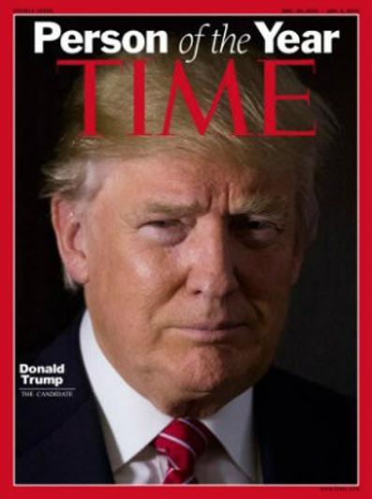
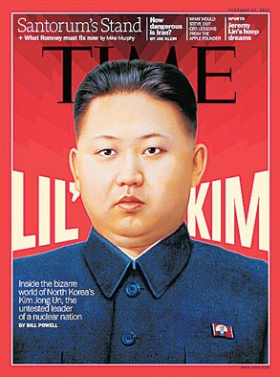
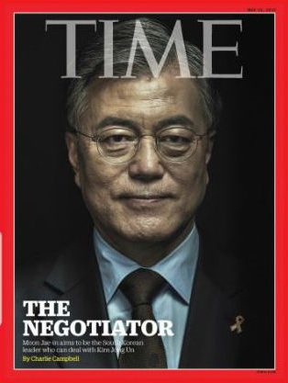
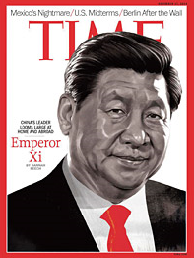
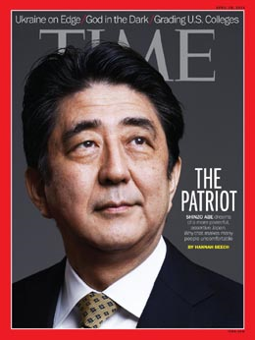
R.O.K.’s Geopolitical Environment
2

Slide 6
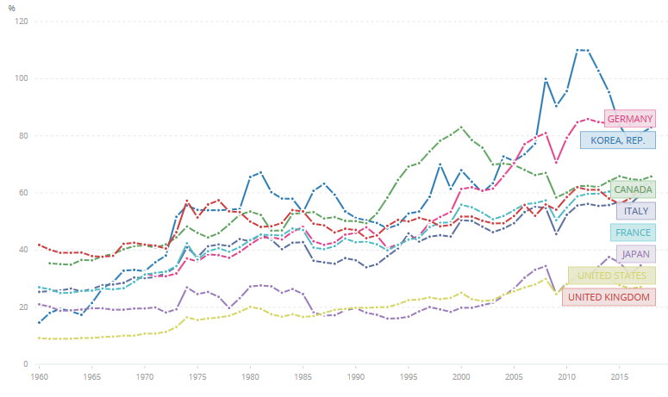
R.O.K’s Trade Dependence
3
Trade(% of GDP)
Source: World Bank national accounts data, and OECD National Accounts data files (https://data.worldbank.org/indicator/NE.TRD.GNFS.ZS , access at Oct. 31, 2019)

Slide 7
Ⅱ. An Overview of Parliamentary Diplomacy

Slide 8
Types of Parliamentary Diplomacy
4
Types of Parliamentary Diplomacy
Parliamentary Diplomatic Actors
• Visits Abroad
• Hosting Visitors
• International Conference
• Online Diplomacy
• The Speaker
• Inter-Parliamentary Associations
• Parliamentary Committees
• Individual MPs
• Political Parties
• Parliamentary Support Groups
Inter-State Parliamentary Diplomacy
• Parliaments
• Political Parties
• Governments
• Private Sectors

Slide 9
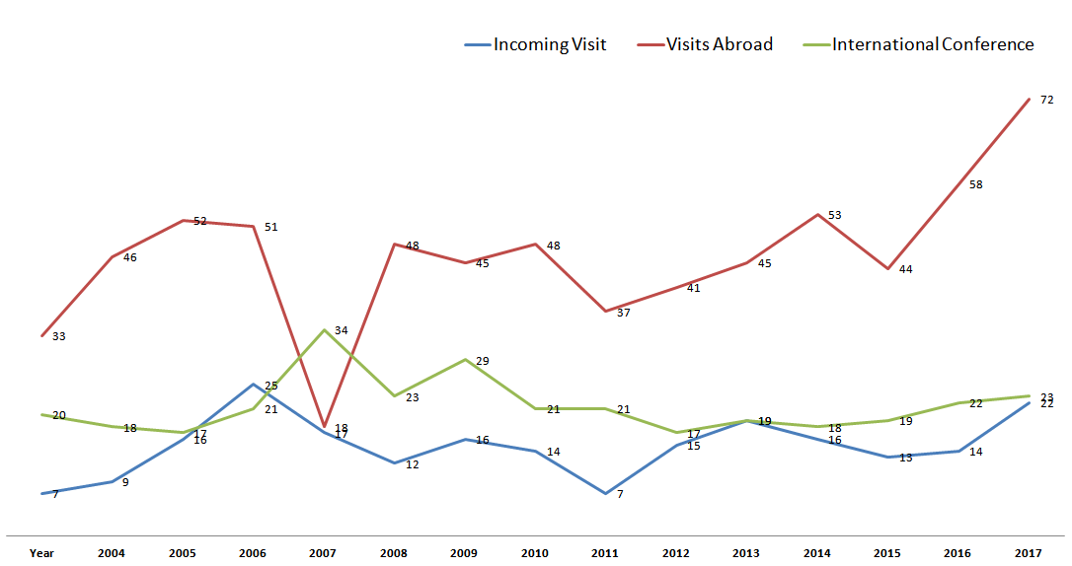
Trends of Parliamentary Diplomacy (by type)
5
Source: Information for Parliamentary Diplomacy(http://ipd.na.go.kr, access at Oct.25, 2019)

Slide 10
Ⅲ. The Current Status of Parliamentary Diplomacy

Slide 11
The Current Status of Parliamentary Diplomacy
6
Existing Parliamentary Diplomacy
Parliamentary Diplomacy through Parliamentary Support Groups
Parliamentary Diplomacy Forum
The Role of
NARS in Parliamentary Diplomacy

Slide 12
Parliamentary Diplomacy Forum
7
외교입국 (“Strengthen the Country through Diplomacy”)
- Advisory Committee for Parliamentary Diplomacy
The Parliamentary Diplomacy Forum consists of key groups of senior members of the South Korean National Assembly who seek to resolve diplomatic issues facing South Korea by communicating with their counterparts and carrying out networking and public diplomacy activities.
• 12 Countries or Regions Worldwide
• Chair Persons (multi-term senior members)
• All 300 Members of Parliament belong to the Forum
• A Forum Advisory Group (with expertise in the country or region)
• NARS’ Support for Parliamentary Diplomacy

Slide 13
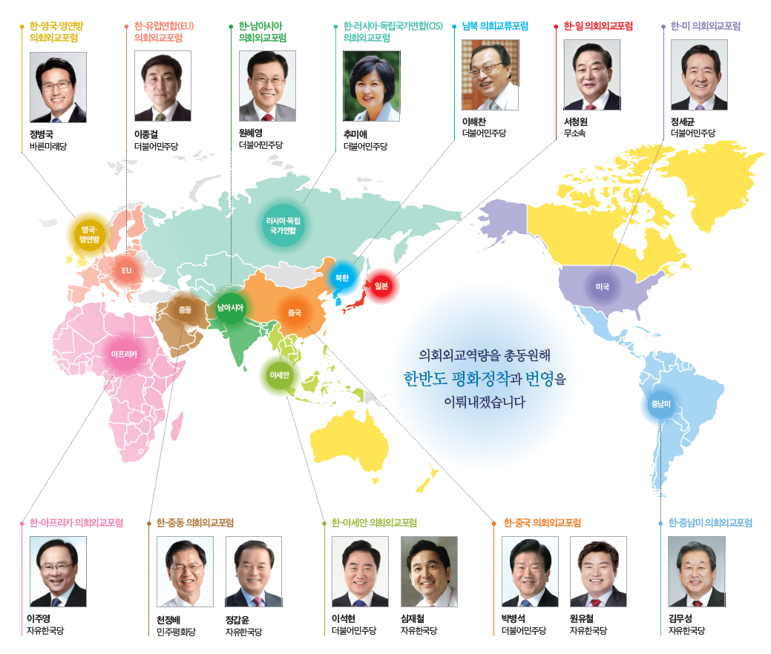
Parliamentary Diplomacy Forum
8
UK·
Commonwealth
EU
South Asia
Russia· CIS
North Korea
Japan
USA
Africa
Middle East
ASEAN
China
Latin America

Slide 14
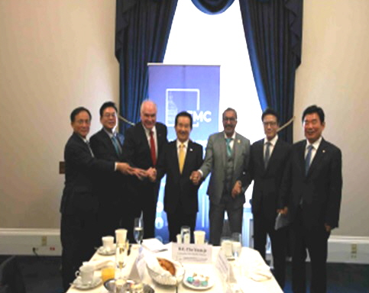
Parliamentary Diplomacy Forum On the U.S.
9
Visit CSGK on May 21, 2019
• Strengthening the Network between the R.O.K. and U. S. Legislatures
• Discussions on the Solutions and Prospects for North Korea's Nuclear Program
• Understanding the ROK-U.S. Alliance and Current Issues
※ CSGK (Congressional Study Group on Korea) is a Korea issue research group consisting of incumbent U.S. Congress lawmakers. It was founded in 2018.

Slide 15
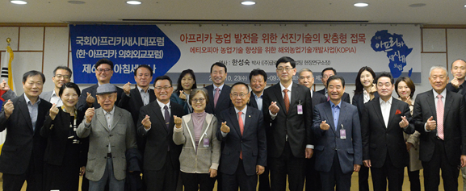
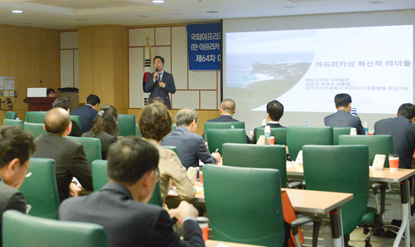

Parliamentary Diplomacy Forum on Africa
10
Weekly Seminars during the National Assembly Session
July 3: “African Development and Our Role”
  Speaker: Ban, Ki-Moon (Former UN Secretary General)
July 10: “Zambia, Eco-Kasaria Project”
  Speaker: Hwang, Chang-Yeon (Priest)
July 17: “Current Status of Development Cooperation in Africa by the World Bank”
  Speaker: So, Hun-Seob (Director, World Bank Korea Office)
Sep. 4: “The Role of the African Development Bank and its Partnership with Korea”
  Speaker: Abdu Mukhtar (Director, the Industrial and Trade Department, AfDB)
Sep. 18 : “A Study on the Development Strategies through the Support of Coffee Industry”
  Speaker: Beaniam Hong (CEO, Beaniam in Africa)
Sep. 25 : “Innovative Leaders in Africa”
  Speaker: Kim, Young-Whan (Professor, Hankuk University of Foreign Studies)

Slide 16
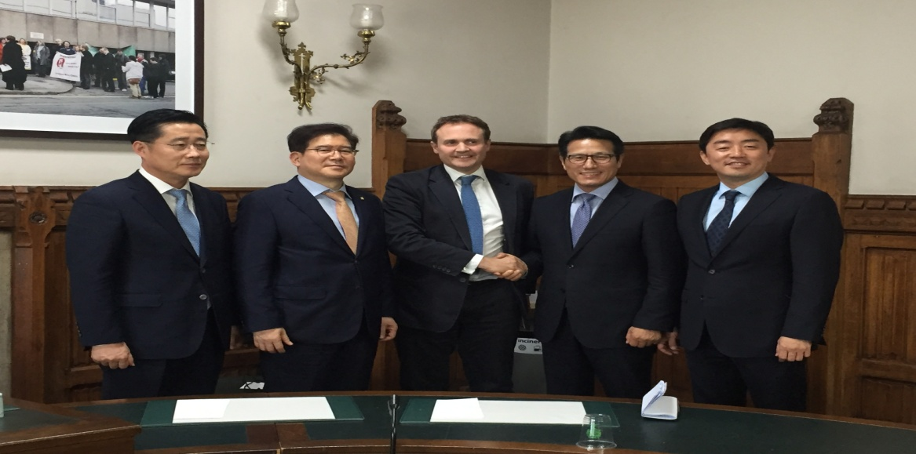
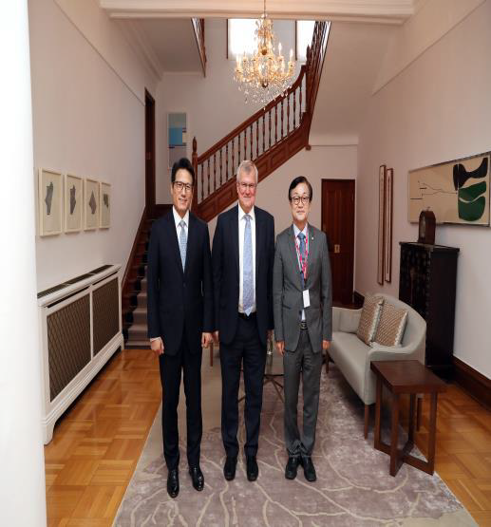
Parliamentary Diplomacy Forum On
the United Kingdom and the Commonwealth
11
1. Visit to the UK on July 1, 2019
2. Meeting with Tom Tugendhat, the Chairman of House Foreign Affairs Committee, on July 3, 2019
A Luncheon Meeting hosted by the British Ambassador to Korea on Aug. 26, 2019

Slide 17
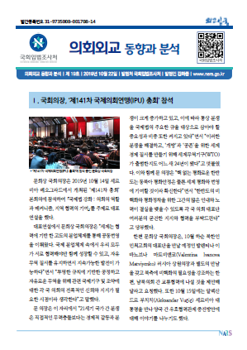
NARS’ Support for Parliamentary Diplomacy
12
Tailored Support
NARS’
International Exchange
• Tailored response to the specific needs of
parliamentary diplomacy.
• Providing information, analysis, and strategic advice
on current issues and agenda.
• Planning and attending expert meetings.
• Preparing speaking notes and delegation reports.
• Accompanying delegations to meetings.
• Networking with experts and congressional support
organizations of partner countries.
Publish
Trends and Analysis of Parliamentary Diplomacy

Slide 18
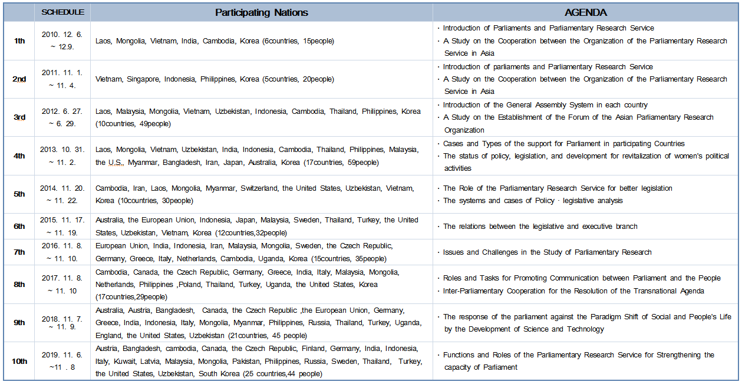
International Seminars for Parliamentary Research Services
13
Overview of International Seminars for Parliamentary Research Services, 2010-2019

Slide 19
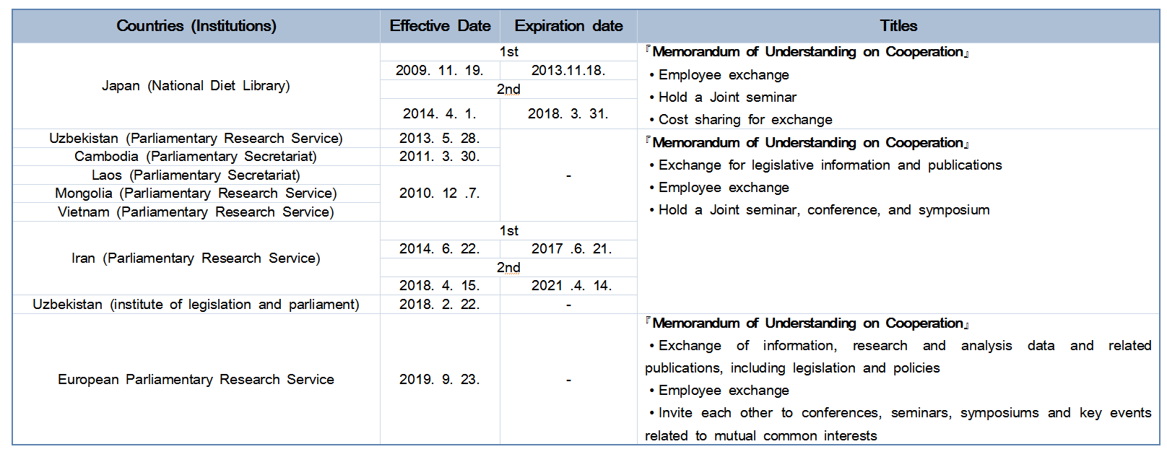
International Exchange of NARS
14
Status of MOUs with Foreign Institutions

Slide 20
Ⅳ. Suggestions for Further Development

Slide 21
Suggestions for Further Development
15
R.O.K. Parliamentary Diplomacy
Parties
Budget
Experts
Organization
Local
Legislative
Executive Branch
Legacy
Speakers
Chairmen
MPs

Slide 22
Thank You!

