Slide 1
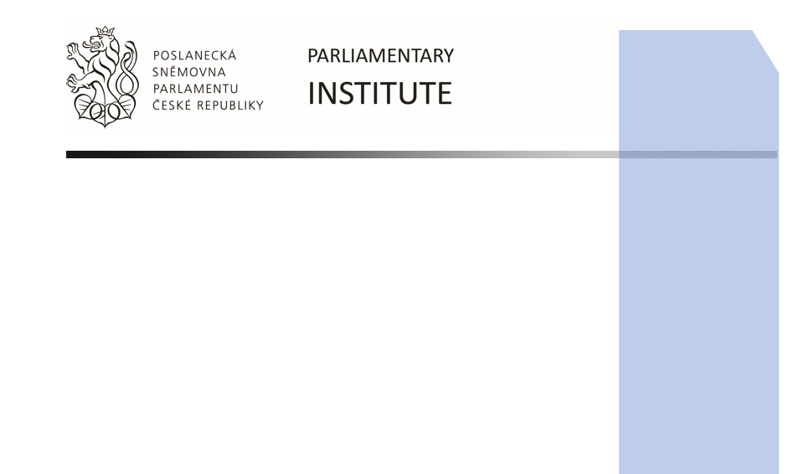
Parliamentary diplomacy & Parliamentary research service
- case of the Czech Republic
Martin Kuta
kutam@psp.cz
Parliamentary Institute (General Analysis Department)
Office of the Chamber of Deputies
Parliament of the Czech Republic
Seoul, South Korea
November 7, 2019

Slide 2
Parliamentary Institute
– scope of activities and structure
  Unit of the
  Office of the Chamber of Deputies
  (CoD)
  In-house scientific (research), informative and educational service
Parliamentary research (studies, briefings, written replies on requests) Research (on demand/regular basis, own research) Advisory assistance to committees (legal opinion on EU legislation), delegations Legislative assistance (compliance check of non-gov bills with EU legislation)
Educational (training) service Seminars for MPs Seminars for the public
Informative service External communication and publication strategy Information to the general public
General
Analysis
Parliamentary research
Political science, IR, economics, constitutional & public law
EU
Affairs
Advisory
/
legislative assistance to committee
EU Legislation
Communication and Education
External communication and publication
Public outreach
EU policies/EU law
History of parliamentarism, PR

Slide 3
Parliamentary diplomacy
Parliamentary diplomacy/Inter-parliamentary cooperation
  Delegation to Parliamentary assemblies of international organizations
  Group of friends (GoF): institutionalized bilateral relations of parliamentarians
Balancing inter-governmental cooperation by fostering inter-parliamentary dimension
Aim of inter-parliamentary cooperation
  Decreasing informational asymmetry allowing for conduct of parliamentary oversight function
  Establishing/fostering various communication channels
Examples of CZ parliamentary diplomatic activities
  Cuba (2001)
  Pre-accession activities of CZ Parliament – joint delegation to EP (1998–2004)

Slide 4
Delegations CoD to PA
1996–1998
IPU PA OSCE PA CoE PA NATO PA WEU CEI EP
1998–2002
IPU PA OSCE PA CoE PA NATO PA WEU CEI EP
2002–2006
IPU PA OSCE PA CoE PA NATO PA WEU CEI EP
2004
Accession of the CZ to the EU
2006–2010
IPU PA OSCE PA CoE PA NATO PA WEU CEI
2010–2013
IPU PA OSCE PA CoE PA NATO PA WEU CEI
2013–2017
IPU PA OSCE PA CoE PA NATO CEI
2017–
IPU PA OSCE PA CoE PA NATO CEI

Slide 5
GoF within the IPU Delegation (CoD)
1996–1998
N/A
1998–2002
60
2002–2006
39
2006–2010
49
2010–2013
52
2013–2017
64
2017–
61

Slide 6
Delegations/GoF CoD 1996–2019 – trends?
Shift from countries to regions
Shift from neighbourhood partnerships to global partnerships
Broadening/Deepening of discussed topics
CZ/EU topics

Slide 7
Parliamentary research service for IR/IPC/PD
IPC/PD: decreasing informational asymmetry
Parliamentary dimension/parliamentary perspective
Regular research products (CFSP EU), briefings on international politics
  Elections
  CFSP mechanism/joint attitudes
  → cumulative knowledge → ad hoc briefings on topics/issues
Topics
  Connecting internal-external threat nexus
  Glocalization/globalization (CZ and EU topics)

