Slide 1
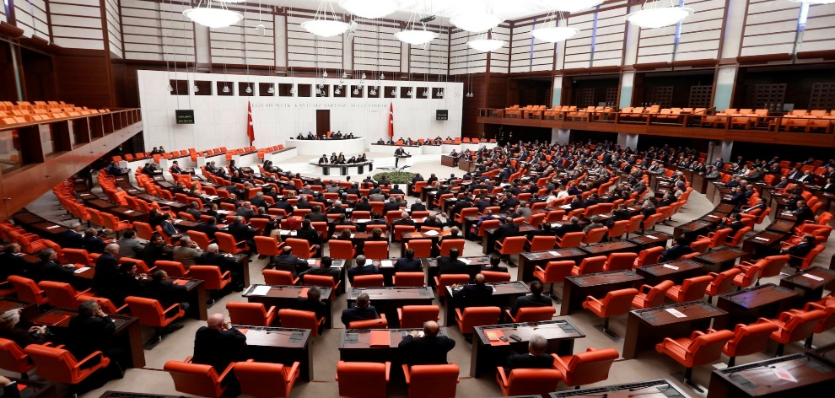
PARLIAMENTARY DIPLOMACY
AND MECHANISM OF
TURKISH PARLIAMENT
Halit Tunçkaşık
Grand National Assembly of Turkey
Reseach Services Department

Slide 2
Two sections:
1-General evaluations on development of P.D
2-Case of Turkey : practices, rules, tendencies on PD.

Slide 3

GENERAL EVALUATIONS
Diplomacy (lexical)
Diplomacy (Term)
Parliamentary Diplomacy (traditional content- 1950-1990)

Slide 4
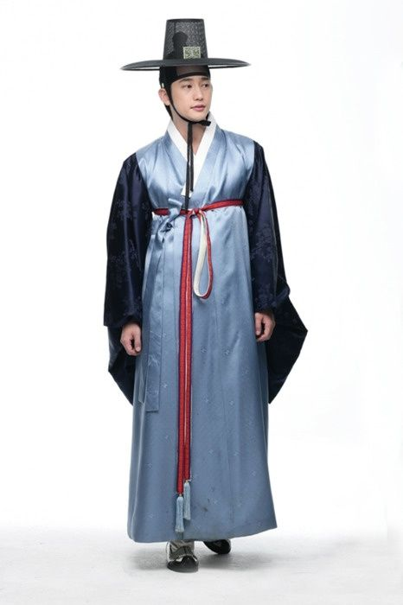
Parliamentary Diplomacy (traditional perception)
Diplomatic representation of states (UN Parliamentary Assembly, Parliamentary Assembly of the CoE).
Parliaments to facilitate the conduct of classical diplomacy.
Parliaments as component of a states foreign policy

Slide 5

Extention of the Content and Reasons
End of bipolar World
Communication Revolution
Inefficacy of traditional diplomacy
Blurring of boundaries
Increased interdependence
Transnational issues

Slide 6
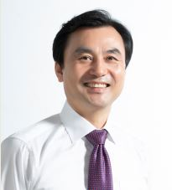
Modern PD / Rich Content
Accumulation of old and new practices
Parliamentary interactions with all foreign entities
Parliamentary as outonomous agents
More active role
Diversification of institutions and methods

Slide 7
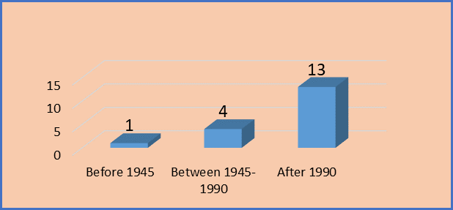
Participation of Turkish Parliament to National Assemblies

Slide 8
Benefits
Flexiblity
Moral advantages
Democratization of international relations
Overcoming blockages
Field specialization

Slide 9
Limits / Challenges
Institutialization
Codification
Powers
Informal nature

Slide 10
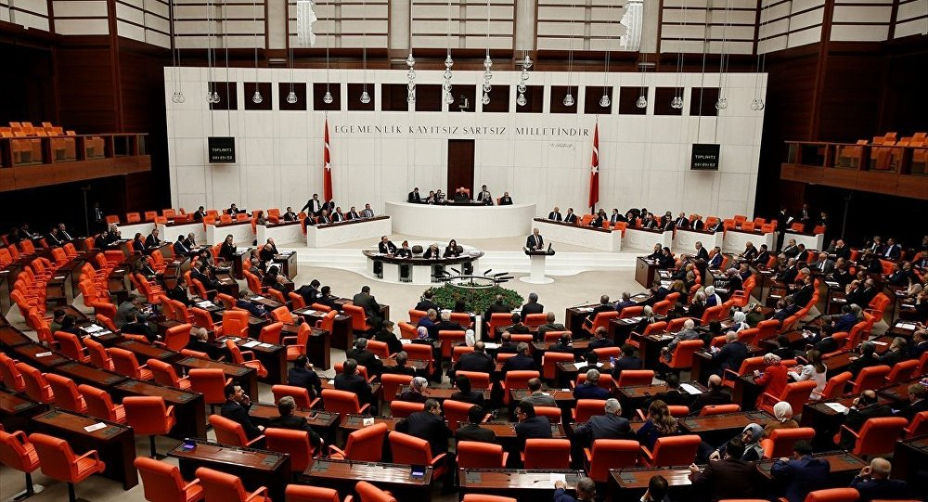
THE CASE OF TURKEY
(Headings)
Activities
Role of the Speaker
Delegations to Parliamentary Assemblies
Turkey-European Union Joint Parl. Com.
Incoming and outgoing delegations
Inter-parliamentary friendship groups

Slide 11
Activities of GNAT
Bilateral visits
Parliamentary assemblies, and joint committee
I.P. friendship groups
International meetings
Private parliamentary delegations to pay official visits
Monitoring the elections
External relations of spesific committees,
The approval of the ratification of international treaties
Sending the Turkish armed forces to foreign countries and to allow foreign armed forces to be stationed in Turkey

Slide 12
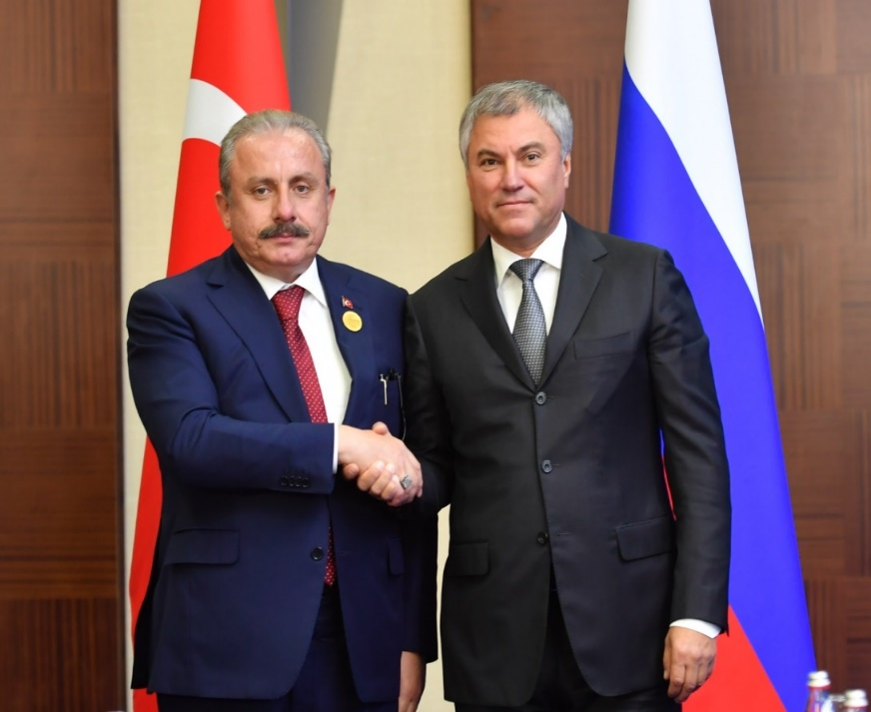
The Role of the Speaker
  Meetings of the Speaker with counterparts,
  Foreign delegations received
  International meetings he/she participates
  Official visits paid to foreign countries etc.
  Hosting multilateral meetings
  Meeting with foreign dignitaries

Slide 13
Delegations of the GNAT to the P.A.
Active participation
Proposal of the Speaker, decision of the Plenary
13 Parliamentary Assemblies
No binding force

Slide 14
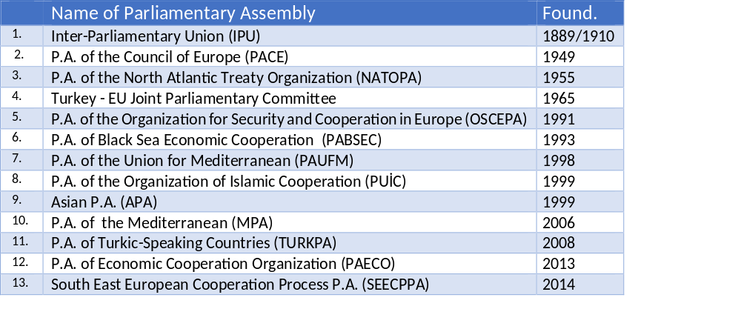
List of P.A. Turkey Joined

Slide 15
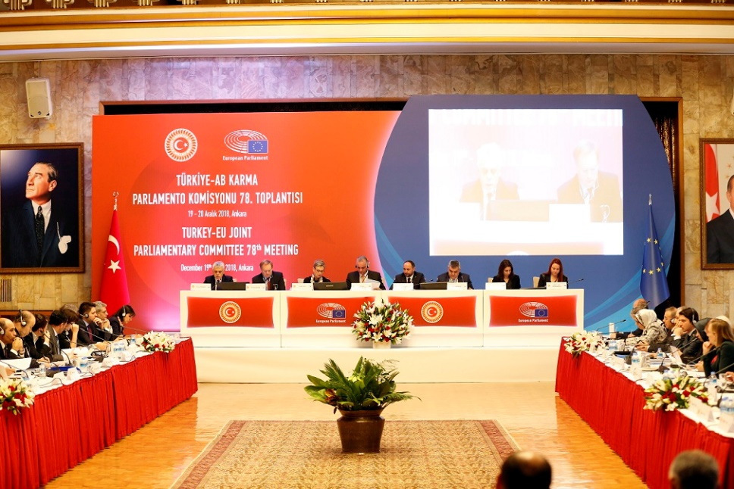
Turkey-EU
Joint Parliamentary Committee
Est: 1965
Parliament as actor of EU accession
Equal numbers from two parliaments
Bureau: Chairpersons and vice-chairpersons of two delegations
Meetings: three times a year; in Ankara and Brussels

Slide 16

The Incoming and Outgoing Delegations
OUTGOING:
Bureau proposes, plenary decides
Invitation is accepted by the plenary
Some congress and conferences are regulated by law.
Number of deputies for each party…
Members are appointed by their party group.
Delegation elects the head.
Committees have different procedures
INCOMING
Bureau decide for invitation, Plenary approve.
Recently number of delegation increases.

Slide 17

Inter-Parliamentary Friendship Groups
Aims
Development of relations
Cooperation
View Exchange
Contribution to solidarity, understanding…

Slide 18
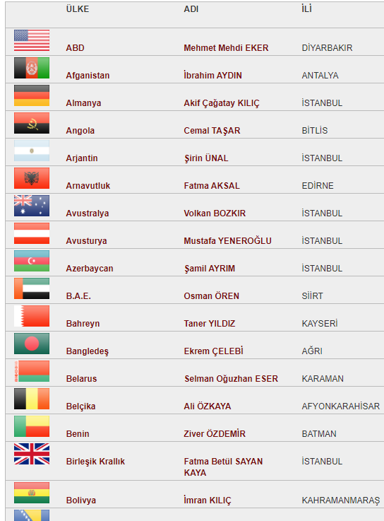
…a number of rules…
Application of ten MP’s
Plenary decision
Right for each MP
Fair share of membership
Single executive board for each MP.

Slide 19
Rise of friendship…

Slide 20

감사합니다
Thank you

