Slide 1
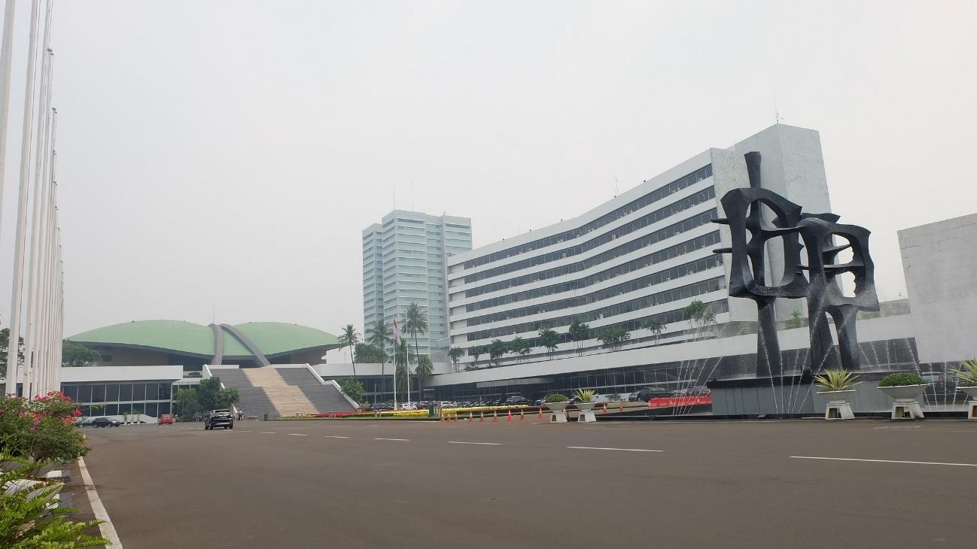
Future Direction of Parliamentary Diplomacy:
the HoR Research Center’s Role
Hariyadi
Research Center, Indonesian
HoR Secgen & Expertise Body
Seoul, 2019

Slide 2
Presentation Outline
Introduction;
Direction of Indonesia’s parliamentary diplomacy: prospects and problems;
What should we reinforce to our capacity?

Slide 3


Introduction
Why is HoR’s diplomacy role important?
Art. 11 (1), (2) of the Constitution:
(1) HoR’s approval on govt. declaration of war, making peace and concluding treaties with foreign countries;
(2) The HoR’s approval on govt. int’l agreements that will produce an extensive and fundamental impact for the people.

Slide 4
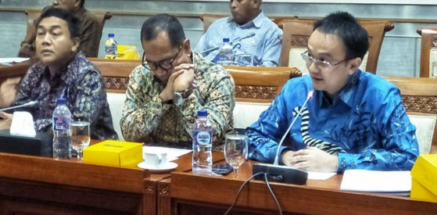
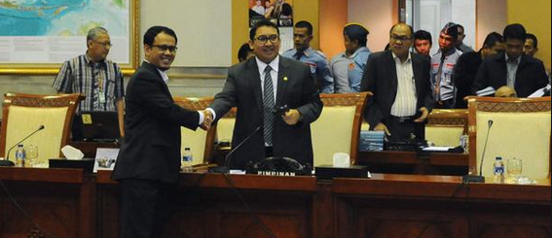
Art.13 of the Constitution:
(2) In appointment of ambassadors, president shall consider HoR’s opinion;
(3) President shall receive the accreditation of ambassadors of foreign states and shall in so doing have consider the HoR’s opinion.

Slide 5
The constitution mandate also endorsed at:
Act No. 37/1999 on FR;
Act No. 24/2000 on IA;
Specific statutory mandate:
Act No. 17/2014 on PCA, HoR, RRC, and Reg. HoR (Art. 69 (2)).

Slide 6
Art. 69 (2):
“HoR’s legislation, budget and oversight functions held in the framework of people representation, and also to support govt’ efforts in embarking on foreign policy...”

Slide 7
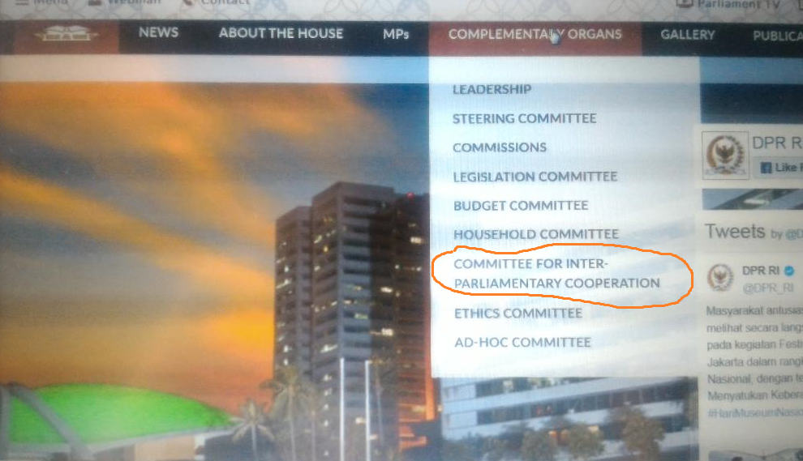
Diplomacy-Concerned Parliamentary Committee(s)
Int’l parliamentary cooperation committee;
Parliamentary subcommittee on enhacing HoR’s diplomacy (Internal Parliamentary Reg. No. 5/DPR RI/III/2017-2018);
Any other committees.

Slide 8
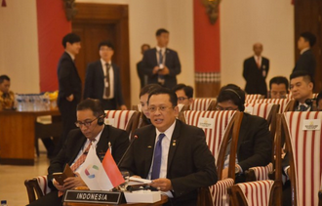
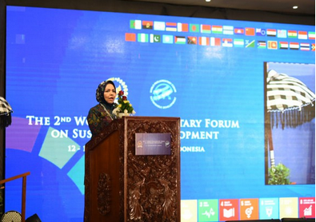
Programs and Activities of
the HoR diplomacy:
Bilateral Missions:
Committees’ visit,
Speakership’s goodwill visits;
Int’l parliamentary chairmanship technical visit;
Bilateral cooperation group visit; and
Multilateral Missions:
Regional parliamentary org. conferences (AIPA, APPF, MSEAP, APA, ASEP),
Int’l Parliamentary Org conferences (IPU, PUIC, GOPAC, MIKTA),
Hosting Regional and Int’l Conferences (IPPP, WPFSD, GOPAC, MIKTA),
Hosting Foreign MPs visits.

Slide 9
Institutional Framework
Macro: Art. 11, 13 (Constitsution); Act No. 37/1999; No. 24/2000 (General Rules)
Formal Institutions
Messo: Act . No. 17 /2014 (Specific Rules)
Informal Institutions
Micro: Parliamentary Committee(s) and Subcommitte (Org. Arrangements) → RoP
Parliamentary Progs. & Activities

Slide 10
Direction for Parliamentary Diplomacy: Prospects and Problems
In the 2014-2019 term of office, HoR diplomacy has shown positive progress to support govt’ foreign policy in issues:
Mainstreaming climate change and SDGs achievement issues (WPFSD; AIPA; IPU, etcs);
Economic issues and int’l trade (parliamentary conference on WTO);
Gender mainstreaming and women participation (APPF; WAIPA);
Human rights crisis, i.e. Palestine, Rohingnya, and migrant workers (IPU, AIPA, AIPA);
Corruptions issue (GOPAC) etcs.

Slide 11
Prospects and Problems of
Parliamentary Diplomacy
Active inter-parliamentary participations and closer collaboration with regional and intel’ parliamentary orgs. will give an impetus for the prospective parliamentary diplomacy
But …problems remain!
Mutual understanding between the govt’ and parliament with regard to the follow-ups of parliamentary diplomacy;
Supporting system for the diplomacy

Slide 12

Our Role
Request- and nonrequest-based supports, among others:
Participations in the parliamentary diplomacy forum (supporting team);
data and analysis relating to issues requested;
Initiate seminars/FGDs on certain issues;
Publish parliamentary journal/books related to issues concerned; etcs.

Slide 13
Our Problems
Staff resources (specialists);
Synergy with committee(s)’ staff or non-organic/political appointees staff (teamwork);
Time constraint due to mandatory supports to other parliamentary committees; etc.

Slide 14
To Reinforce Our Capacity
Trainings for staff/specialists;
Enhancing synergy with committee(s)’ staff or non-organic/political appointees staff (teamwork);
Networkings with MoFA and other govt’ ministries/institutions;
Parliamentary diplomacy database;
Supports for parliamentary caucus;
“Public consultation” through seminars/FGDs.

Slide 15
Thank you

