Slide 1
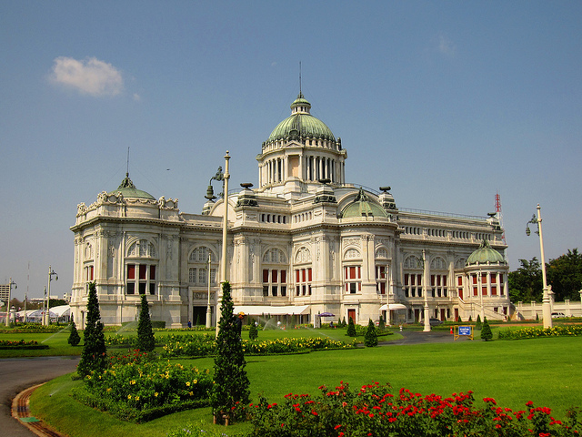
The Members of the National Assembly of Thailand
Academic Support Services for
The House of Representatives and the Senate

Slide 2

The National Assembly of the Kingdom of Thailand
The National Assembly of the Kingdom of Thailand is a bicameral body.
The business of the National Assembly takes place in both Houses : making laws (legislation), overseeing the Executive, approving issues in relevant to national importance and debating significant issues.
The House of Representatives is also responsible for controlling government expenditure through the approval of annual appropriations bill and work in the constituency.
The Senate has sole power to approve, recommend or select persons to hold positions as prescribed in the Constitution and remove key persons from offices.

Slide 3
Secretariat Offices
Each House has its own staff and secretariat office as the supporting unit. The Secretariat of the Senate has responsibilities in supporting duties of the Senate, while the Secretariat of the House of Representatives has roles to enable the Representatives to perform their legislative duties and constituent responsibilities.
The Bureau of Academic Services, under the authorisation of the Secretariat of the House of Representatives, and the Bureau of Parliamentary Studies, under the Secretariat of the Senate, play significant roles in providing academic services to assist legislative tasks of the National Assembly Members and also make academic resources available for the public.

Slide 4
Academic Services for the Members
The Bureau of Academic Services and the Bureau of Parliamentary Studies carry out similar functions :
to collect and disseminate information regarding legal, political, economic, social and policy issues
to render opinions on matters of public concern
to produce academic documents for the Members
to conduct research projects
to provide access to archives
to operate library
to collect and maintain documents and materials regarding the legislative and democratic history of the country

Slide 5
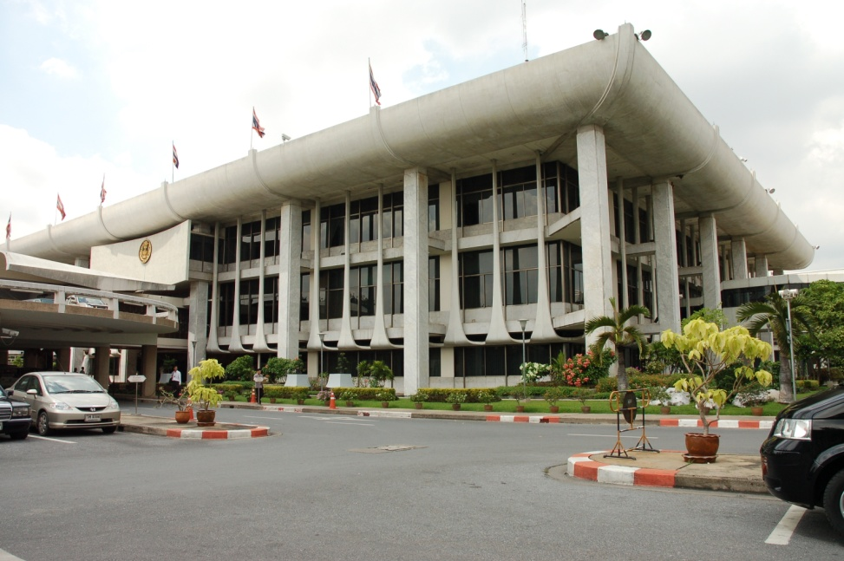
Bureau of Academic Services
The Bureau of Academic Services
The Secretariat of the House of Representatives
8 divisions : General Administration Division
Library Division
Information Technology Resources Development Division
Academic Services Division 1
Academic Services Division 2
Academic Services Division 3
Research and Development Division
Museum and Archives Division

Slide 6

Bureau of Academic Services
Bureau of Academic Services
The Secretariat of the House of Representatives
127 officers, including 39 Parliamentary Officers (Academic Officers), 10 Legal Officers and 21 Librarians
The Research and Development Committee is composed of 14 committee members, six of them are government officials from the Secretariat of the House of Representatives and the rest are professors who are expert in research methods from academic/ educational institutions.

Slide 7
Bureau of Academic Services
Academic/Research Services :
to produce documents for the consideration of bills, motions, international agreements (supporting for the first reading of the House of Representatives and joint sittings of the both Houses);
to conduct quick research on the requests of the Members and Committees;
to produce academic documents with the purpose of examining current and potential legislative, political, economic and social issues;
to render opinions on bills, laws, regulations and specific issues of public awareness;

Slide 8
Bureau of Academic Services
Academic/Research Services :
to translate academic documents on the requests of the Members and Committees;
to work on research projects, particularly politics, public administration, legislation and the roles of legislative branch;
to act as the coordinator among research institutions, professors and the Research and Development Committee in research projects;
to promote research activities, for example, providing financial supports to students who work on theses about democracy and parliamentary affairs, and disseminating research results; and
to provide access to the archives collections.

Slide 9

The Bureau of Parliamentary Studies
The Secretariat of the Senate
4 groups :
- General Administration Group
- Research and Information Group
- Library and Museum Group
- Monitoring and Evaluating the Senate
Outcome Group
36 officers, including 13 Parliamentary Officers (Academic Officers), 5 Legal Officers and 2 Librarians
The Research and Development Committee is composed of 15 committee members, including Members of the Senate, government officials from the Secretariat of the Senate and external experts. The Second Deputy Senate Speaker is the ex-officio Chairman of the committee.

Slide 10

The Bureau of Parliamentary Studies
Academic/Research Services :
to search, collect, analyse and study in the areas of politics, economics, social issues, government and security;
to provide information, academic articles and research papers as requested by the Senators, officials and related persons;
to provide additional documents to support deliberation of general motions for the Senate;

Slide 11

The Bureau of Parliamentary Studies
Academic/Research Services :
to collect and maintain historical documents and materials regarding the legislative and democratic history of the country and provide archive services;
to monitor and evaluate the Senate’s legislative works according to its resolutions and the Senate’s administrative supervision of the government; and evaluate internal and external circumstances to present and advice the Senate and the Secretariat of the Senate.

Slide 12
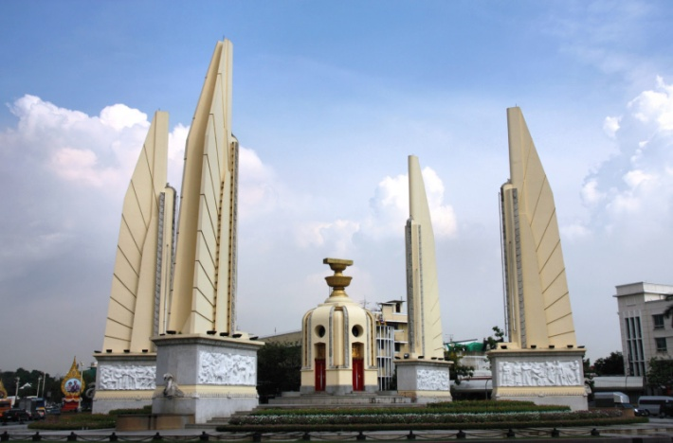
Service Efforts and
Accomplishments Performance Measures
Comply with Royal Decree on Rules and Procedures for Good Governance Act B.E. 2546 (2003), Constitution of the Kingdom of Thailand B.E. 2550 (2007), good governance principles and ethical practice
Carry out the Strategic Plans of the Secretariat offices
Use strategic management tools such as key performance indicator (KPI)

Slide 13
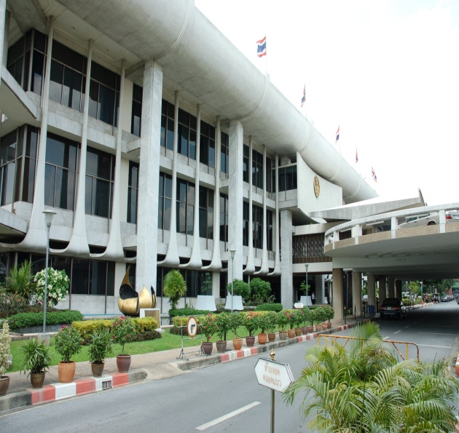
Service Efforts and
Accomplishments Performance Measures
Introduce Bureau of Academic Services Standard Practice Manuals
Conduct service satisfaction surveys
Create proactive services such as digital library and online contents
Develop officers’ knowledge as well as technical/professional, computer and English skills

Slide 14
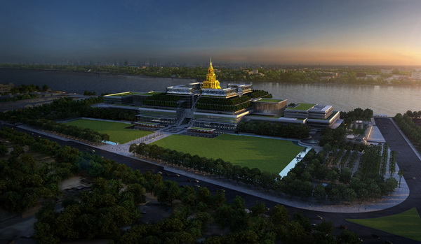
Sappaya Sapasathan
The New National Assembly Building of the Kingdom of Thailand
*The place of wisdom and the centre of the people*

Slide 15
Thank You
http://www.parliament.go.th

